Slide 1
2 point perspective

Slide 2
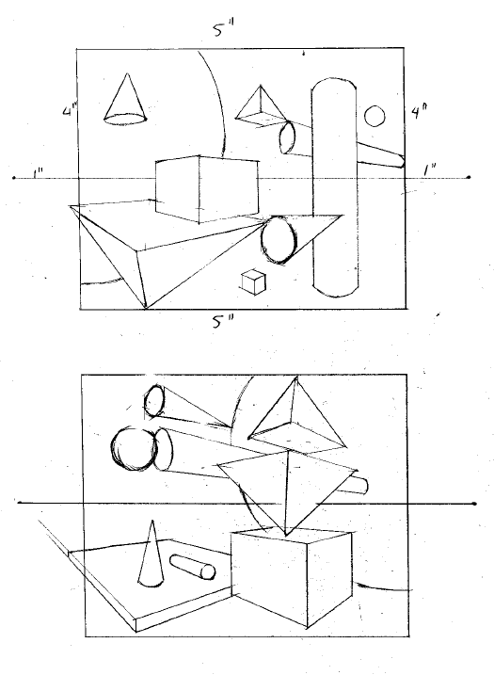
Thumbnail (rough) sketches
Create 2 different thumbnail compositions in your sketchbook.
Each thumbnail measures 5”x4”.
Draw a horizon line that extends 1” beyond the boarders on each side. Place the vanishing points on the ends.
Each thumbnail drawing should have
4 different forms (each drawn twice, different sizes and different directions).
The largest form should be drawn using the rule of thirds creating a focal point in the composition
Try to add variety and balance to the composition

Slide 3
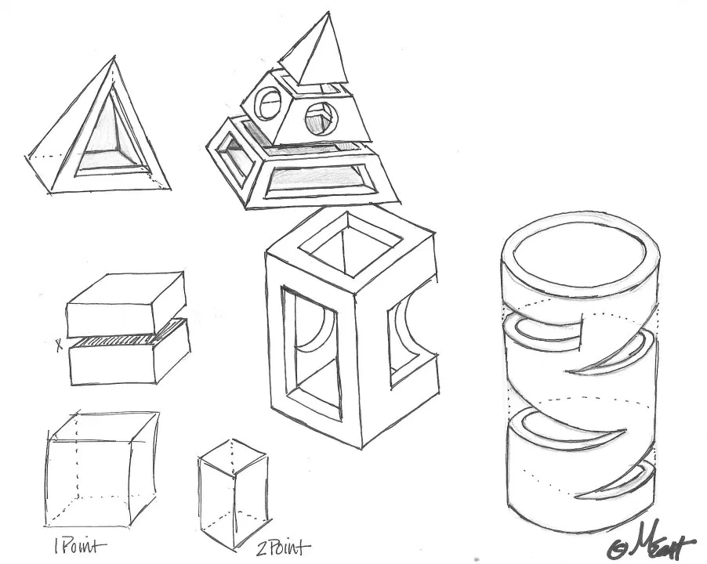
Final drawing
8 forms
Cut each form
2 point perspective
Fill the page!

Slide 4
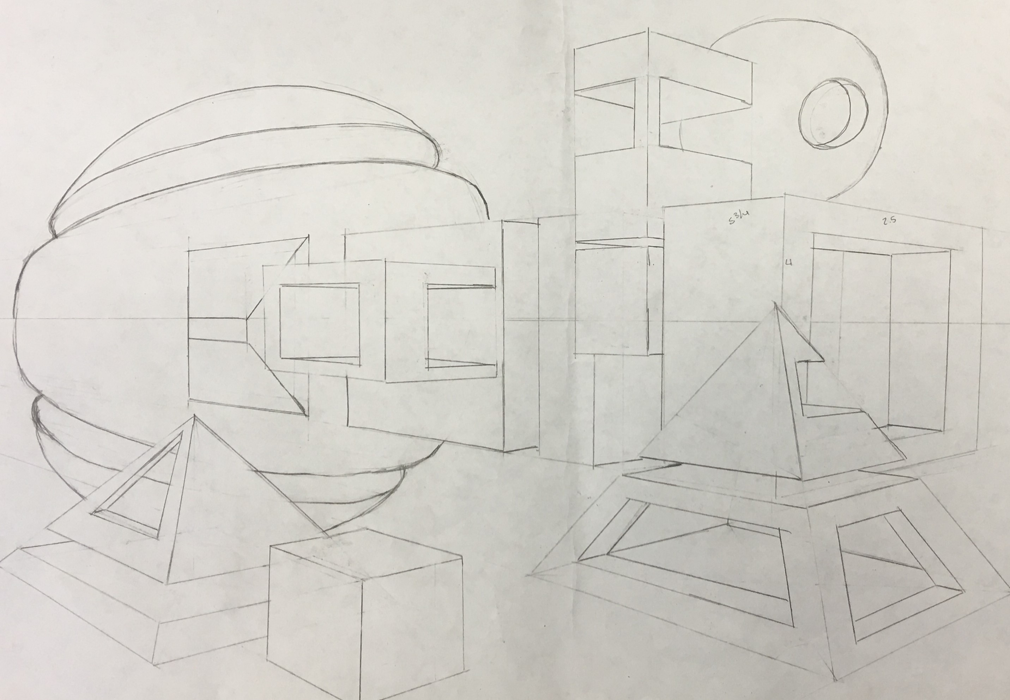
Grading requirements for drawing composition
Objects drawn correctly in 2-point perspective. (25 points)
Minimum 8 forms with 2 of each type. (25 points)
All forms sliced or cut open using 2-point perspective. (25 points)
Composition fills the page, touching at least 2 sides and follows the rule of thirds. Emphasize a large focal point.(25 points)

Slide 5
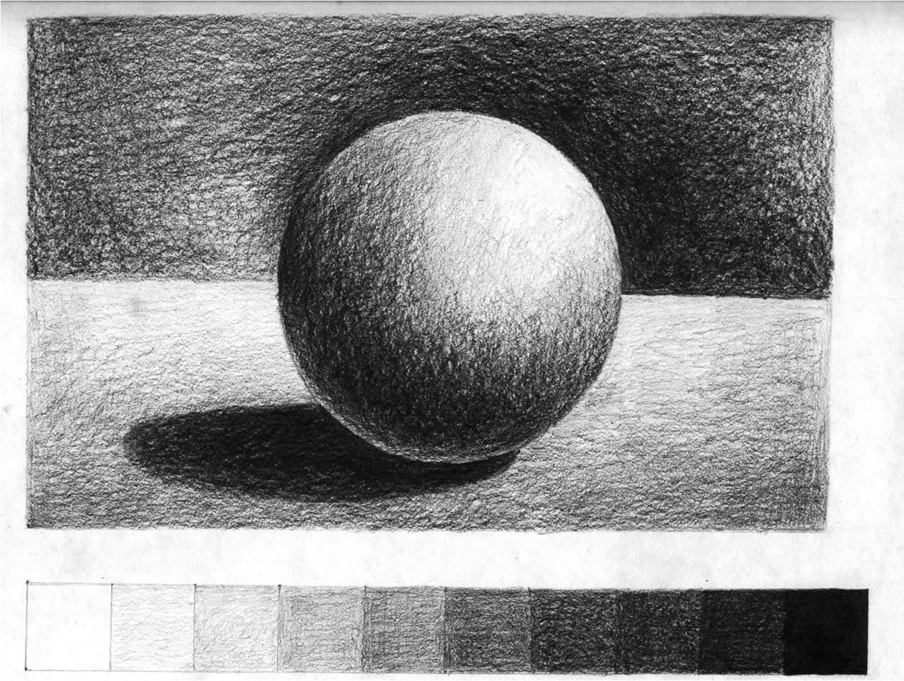
5 values, no lines, blend together, stay in the lines

Slide 6
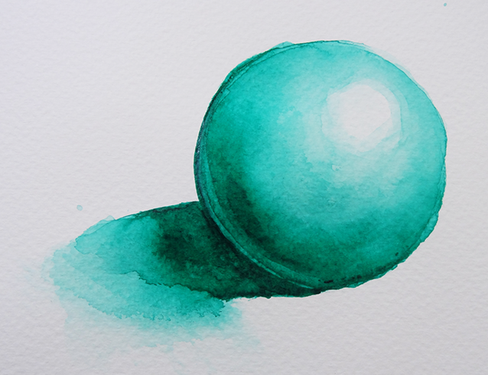
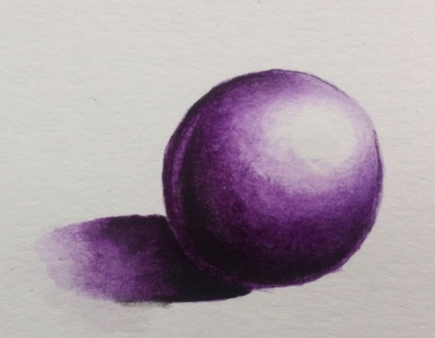

Slide 8
Part 2 Add creativity to the drawing!
5 objects
Common theme
Interacting with forms

Slide 9
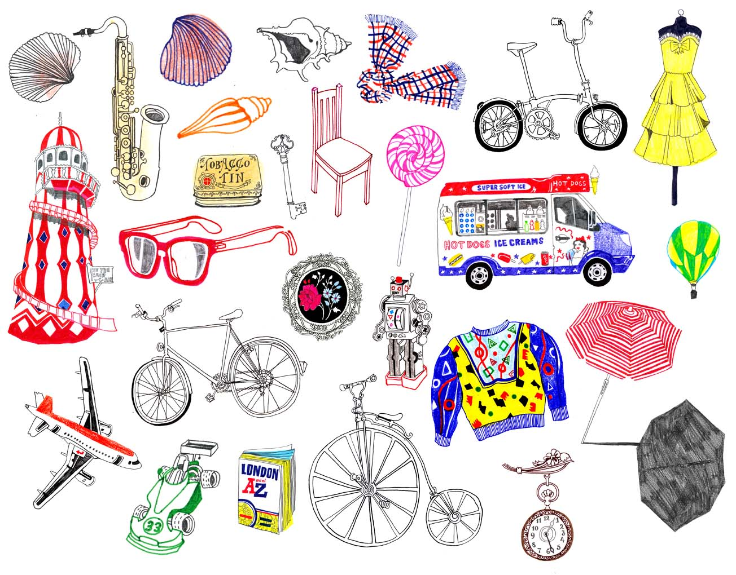

Slide 12
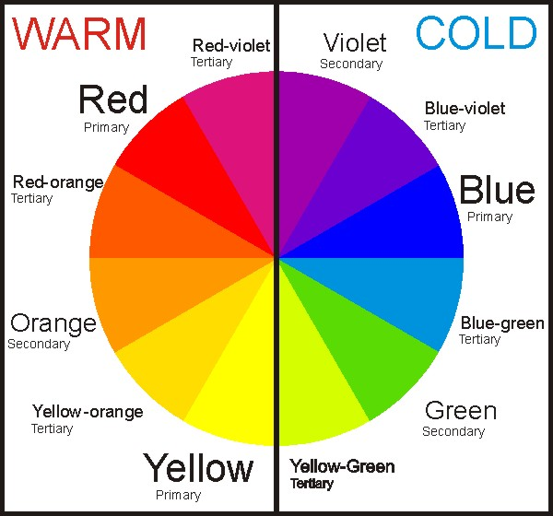
Forms vs. Background

Slide 13
Checklist
8 forms with cuts
5 objects interacting with forms
Paint forms Warm –OR- Cool colors
Paint light to dark with light source

Slide 14
Grading requirements for the creative aspect to the drawing
A common theme to your objects
Creatively placed objects-doing something
Uniqueness to your chosen objects

